Slide 1
Translating Research Gaps into Method
Francis Oloo (Dr. rer. Nat)

Slide 2
Outline
Identify and articulate research gaps
Translate gaps into research objectives, questions and hypothesis
Align objectives with quantitative and social science methods

Slide 3
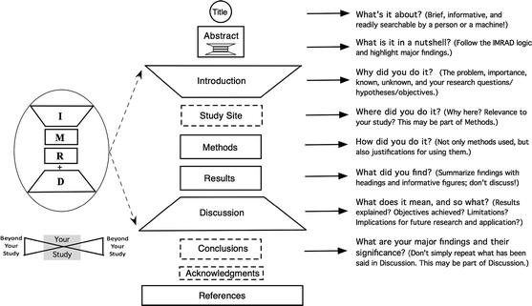
Recap on IMRAD method

Slide 4
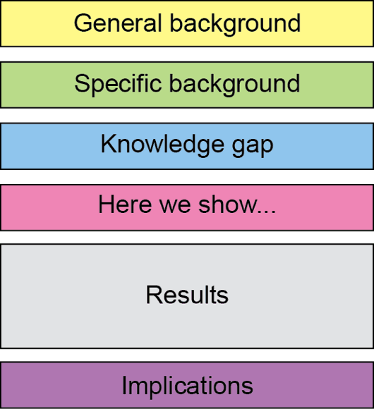
Recap on Abstract

Slide 5
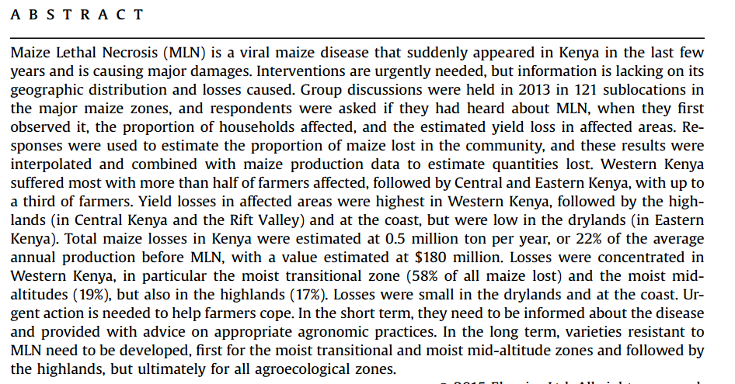
Recap on Abstract

Slide 6
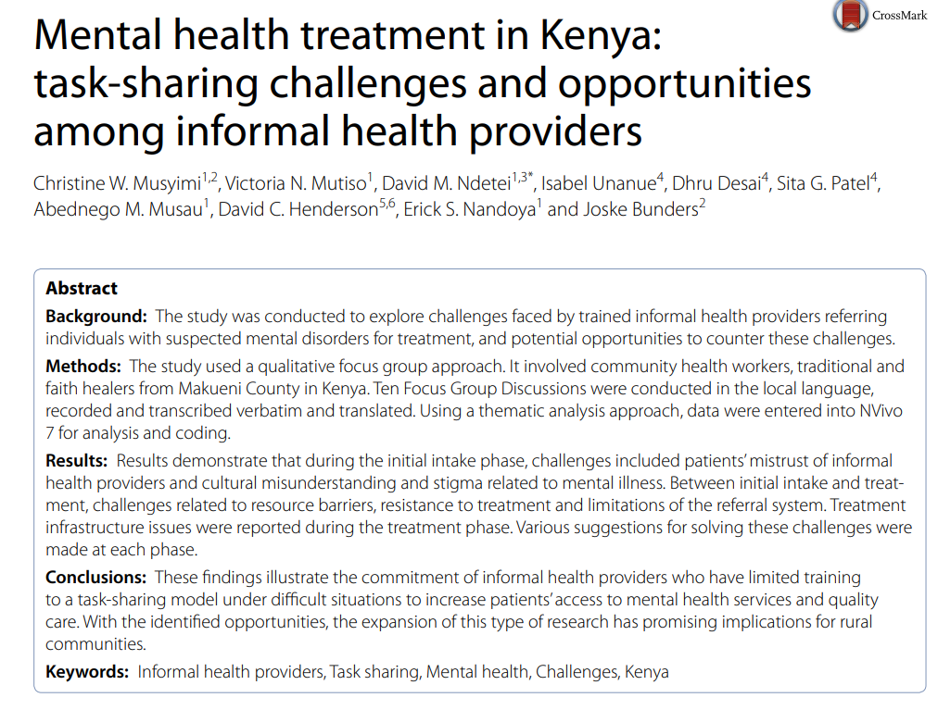
Recap on Abstract

Slide 7
Discuss some examples from participants

Slide 8
What Is a Research Gap? Gap-Spotting vs. Problematization
Gap-Spotting
Problematization
Identifying something existing literature has not yet covered, the most common approach
Questioning the underlying assumptions of existing literature itself, rarer, often more influential
Common gap types
Empirical → not yet measured in a setting
Theoretical → existing theory doesn't explain it
Methodological → prior methods had limitations
Contextual/geographic → untested in this region
Population → an under-studied group
42

Slide 9
Moving from Gap to Objectives: Aims, Questions, Hypotheses
Term | Function | Examples
Aim | Broad overall purpose | Improve understanding of smallholder drought resilience Assess the impact of urban greening on urban quality of life
Objective(s) | Specific, achievable steps | Quantify yield effect of a drought-tolerant variety under three rainfall scenarios Develop a model for predicting the influence of climate on mental health
Research question | Open question (qualitative/exploratory) | How do farmers decide whether to adopt a new variety? Does increase in diurnal temperature influence sleep patterns of children?
Hypothesis | Testable, falsifiable prediction (quantitative) | H1: Yield loss under drought is lower for the new variety
43

Slide 10
Reread your abstract and identify a research aim, objective or question

Slide 11
Aligning Objectives to Methods: The Golden Thread
Gap → Objective → Question/Hypothesis → Method → Analysis → Discussion
Measure / quantify / compare / test a relationship
→ Quantitative methods (experiments, surveys with statistics, modelling)
Explore / understand / explain a process or meaning
→ Qualitative methods (interviews, focus groups, case studies, ethnography)
Requires both magnitude and meaning
→ Mixed methods
45

Slide 12
Quantitative Example: Agricultural Field Trial
IMRAD Element | Content
Gap | Limited independent quantification of yield differences between a drought-tolerant variety and the local check
Objective | Quantify the yield difference across a gradient of drought stress
Hypothesis | H1: Mean yield loss under drought is significantly lower for the drought-tolerant variety
Methods | Randomized complete block field trial; ANOVA and regression against a drought stress index
Discussion | Whether the yield advantage justifies variety replacement programmes
Session 3 — Gaps, Objectives & Methods (IMRAD)
47

Slide 13
Qualitative Example: Perceptions of Early Warning Systems
IMRAD Element | Content
Gap | Unclear how pastoralist communities perceive and trust a new drought early-warning system
Research question | How do community members perceive the credibility and usefulness of the system?
Methods | Case study design: focus group discussions and key informant interviews; framework analysis
Discussion | Implications for redesigning the system's communication and trust-building
49

Slide 14
SESSION 3 · 11
A Mixed-Methods Example
Convergent
Explanatory Sequential
Exploratory Sequential
Quantitative + Qualitative strands collected in parallel, merged at interpretation to see where they agree or diverge
Quantitative phase (e.g., survey) followed by qualitative phase (e.g., interviews) to explain the results
Qualitative phase identifies locally meaningful strategies; informs a subsequent quantitative instrument
Example: Quantify how widespread a practice change (e.g. indigenous seed propagation) has been (survey) → Explain why (interviews with a subsample) → integrate both in the Discussion.
50

Slide 15
Writing the Methods Section to Match Objectives
Does every objective have a corresponding method that could plausibly answer it?
Is the sampling strategy appropriate and justified for that objective?
Is the data collection procedure described in enough detail for replication?
Is the analysis plan explicitly linked to the hypothesis or question it addresses?
Are ethical considerations addressed?
Session 3 — Gaps, Objectives & Methods (IMRAD)
51

Slide 16
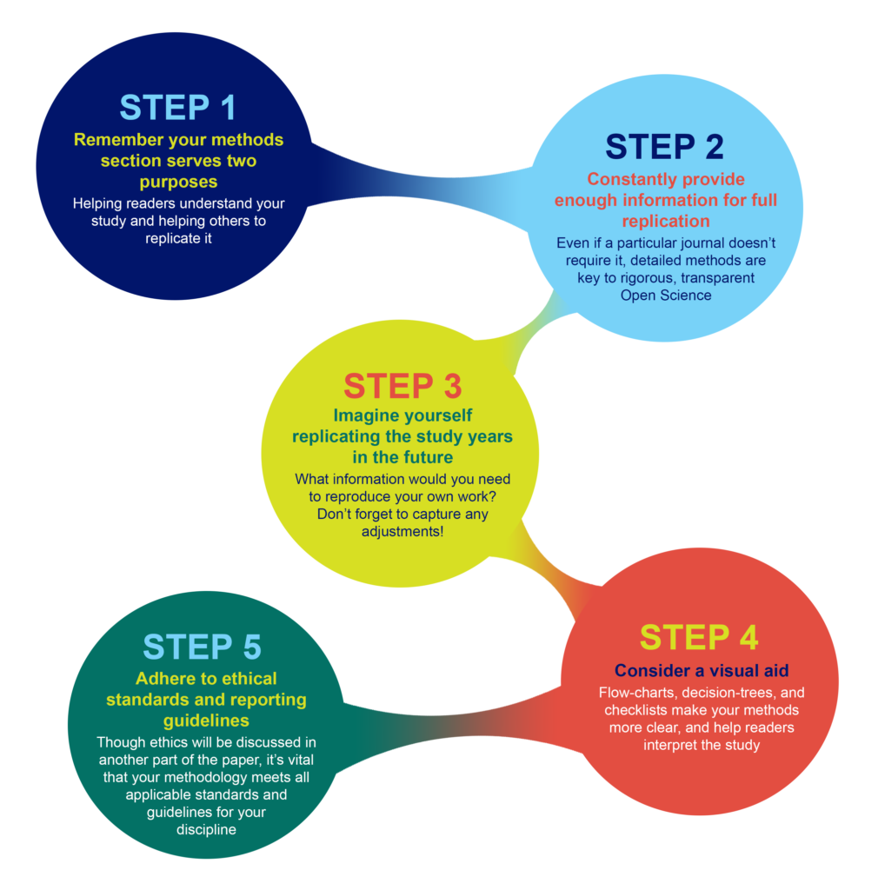
Write according to the specifications of your field
Explain your methodological and data collection approaches in detail
Explain, each methodological step in detail so that others can replicate your work ← Transparency
When apply other’s methods and formulars , properly cite
Ensure that each objective has been adequately addressed in the methods

Slide 17
Examples

Slide 18
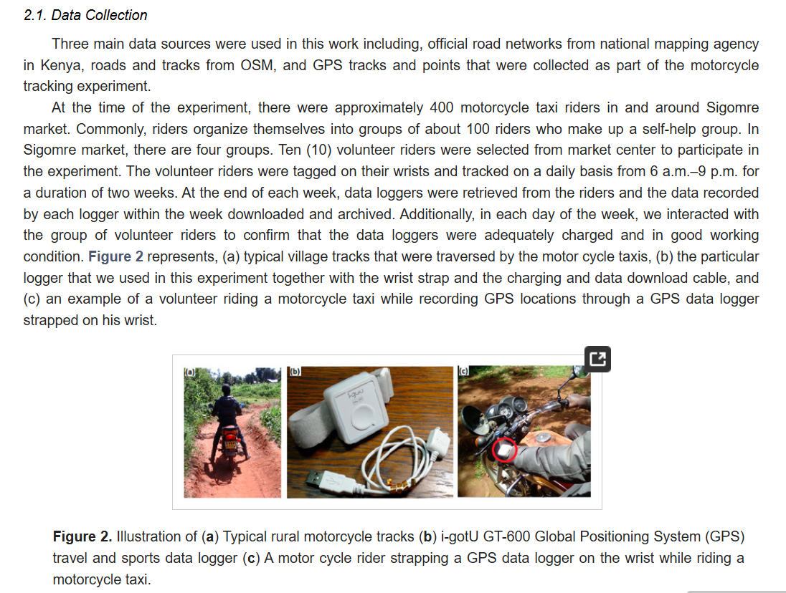
A detailed description of data collection methods

Slide 19
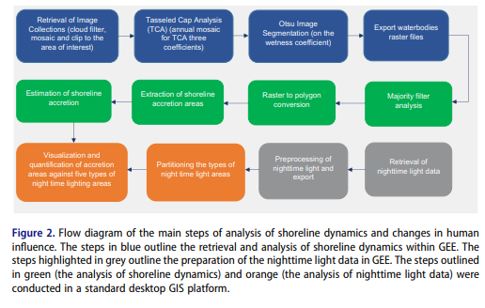
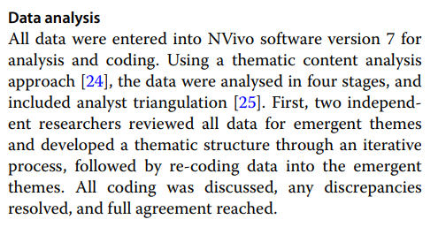
Using graphical aides to support in documenting methods

Slide 20
Description of qualitative data analysis methods and citing additional methods

Slide 21
Assignment: Relook at your work, identify the gap, research objectives, and potential methods for each objective, and organize as below
IMRAD Element | Content
Gap | State a clear gap of your research (1)
Research Aim | State the overall aim/purpose of your research
Specific Objectives | Outline 3-4 specific objectives of your research
Methods | For each specific objective, outline and briefly describe the main methodological steps
49

Slide 22
Questions and discussions

